Slide 1
DATA ANALYTICS Sanela LAzarevski
https://www.simplilearn.com/data-science-vs-big-data-vs-data-analytics-article

Slide 2
Learning Objectives
After studying this topic you should be able to:
Understand what is Data Analytics
How does it relate to Data Analysis
Visualisation
Critique the development of data mining
Determine the advantages of Data Mining across a variety of applications

Slide 3
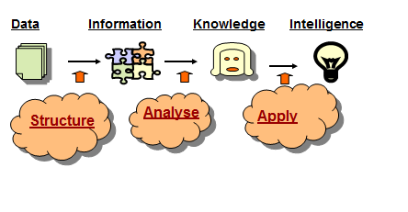
Data > Information > Knowledge
Data
Structured, Semi Structured, Unstructured data, live data (twitter), data sources, bought in data,
Data Quality …
Information
Reports – descriptive, relational
Interactive reports – drill up/down, OLAP
Patterns, trends
Knowledge
Predictions
Understanding
Links
Business Intelligence

Slide 4
inTRODUCTION
https://www.coursera.org/lecture/decision-making/what-is-data-analytics-mnIej

Slide 5
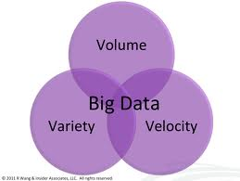
What is ‘Big Data’?
Big data is (‘3Vs’ model):
high-Volume (amount of data & number of clients),
high-Velocity (speed of data in and out),
high-Variety (range of data types and sources)
Big data – is information assets that require new forms of processing to enable enhanced decision making, insight discovery and process optimization.
(c) Gartner

Slide 6
Big Data
Unstructured data will account for 90 percent of all the data created
the number of files are expected to grow 75 times over the next decade
As the ability to create data expands exponentially, our ability to analyse and convert it to information and knowledge becomes the primary barrier to progress

Slide 7
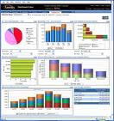


What is Business Intelligence?
Business Intelligence enables the business to make intelligent, fact-based decisions
Aggregate Data
Present
Data
Enrich
Data
Inform a Decision
Database, Data Mart, Data Warehouse, ETL Tools, Integration Tools
Reporting Tools, Dashboards, Static Reports, Mobile Reporting, OLAP Cubes
Add Context to Create Information, Descriptive Statistics, Benchmarks, Variance to Plan or LY
Decisions are Fact-based and Data-driven

Slide 8
Business Intelligence
https://www.youtube.com/watch?v=hDJdkcdG1iA
Dimensions! data marts …

Slide 9

Definition
Data analytics (DA) is the process of examining datasets in order to draw conclusions about the information they contain, increasingly with the aid of specialized systems and software.
Data analytics refers to qualitative and quantitative techniques and processes used to enhance productivity and business gain. Data is extracted and categorized to identify and analyze behavioral data and patterns, and techniques vary according to organizational requirements.
Data analytics (DA) is the process of examining data sets in order to draw conclusions about the information they contain, increasingly with the aid of specialized systems and software. Data analytics technologies and techniques are widely used in commercial industries to enable organizations to make more-informed business decisions and by scientists and researchers to verify or disprove scientific models, theories and hypotheses.
Notes:
http://searchdatamanagement.techtarget.com/definition/data-analytics

Slide 10
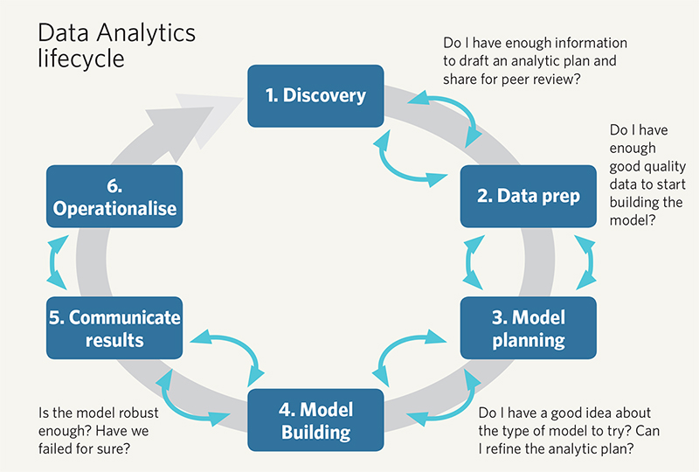
Lifecycle of data analytics

Slide 11
Some examples
https://www.coursera.org/lecture/decision-making/solving-business-problems-using-data-analytics-bxX55
https://www.youtube.com/watch?v=8hHf32pMeu8
Tableau prep
Also check out:
https://www.tableau.com/learn/training

Slide 12
Data Analytics
the process of compiling data
Using Data Analysis and Data Mining
Using code SQL, Python, R
analysing data
data cleaning, data analysis, modelling, predictive modelling and so on.
tools / software
Tableau, SAS, SAP, JMP
Techniques
Data mining, machine learning

Slide 13
Types of analytics
Descriptive – what is happening – leading to inference (trends, patterns)
Diagnostic – why is it happening - correlation
Predictive – what is likely to happen
Prescriptive – best course of action
https://www.youtube.com/watch?v=y3DNsifFOwo
(not showing now) https://www.coursera.org/lecture/decision-making/types-of-data-analysis-techniques-MpFm6

Slide 14
What is Data Visualisation
Data visualization is the presentation of data in a pictorial or graphical format.
people have depended on visual representations
the human brain processes information
faster for people to grasp the meaning of many data points
rather than poring over piles of spreadsheets or reading pages and pages of reports
Notes:
the way such as charts and maps to understand information more easily and quickly

Slide 15
When did it all start
Long time ago…
Before 17th century: maps of land markers, cities, roads and resources
18th century was start of thematic mapping: geologic, economic and medical data…
First use of pie chart
19th century is called the Golden Age of statistical graphics (e.g. outbreak of epidemic)
60s and 70s areas of statistics and cartography
80s start of Visual display of quantitative information
Notes:
Read the article: http://www.dundas.com/blog-post/a-brief-history-of-data-visualization/

Slide 16
Why is Visualisation important
Visualizations convey information in a universal manner and make it simple to share ideas with others
help people see things that were not obvious to them before
Even when data volumes are very large, patterns can be spotted quickly and easily
Data visualization makes interpretation easier
Notes:
Consider the manufacturing director of product reliability for an international company that produces small vibrating cell phone motors. One of the director’s principal responsibilities is to determine how reliable the cell phone motors will be with each year of age. If the product’s reliability falls short of the standards set forth by the cell phone manufacturers who use the motors, his company could lose major contracts.

Slide 17
Limitations
the amount of data collected
cannot visually represent the information due to data presentation limitations
if printed out, e.g. the spread sheets would be a humongous pile of paper

Slide 18
Visualization Techniques
Understand the data
Determine what you are trying to visualise
Know your audience
Use a visual that conveys the information in the best and simplest form
Data visualization is an art and a science unto itself
Notes:
Understand the data you are trying to visualize, including its size and cardinality (the uniqueness of data values in a column).
Determine what you are trying to visualize and what kind of information you want to communicate.
Know your audience and understand how it processes visual information.
Use a visual that conveys the information in the best and simplest form for your audience.
Data visualization is an art and a science unto itself, and there are many graphical techniques that can be used to help people understand the story their data is telling.

Slide 19
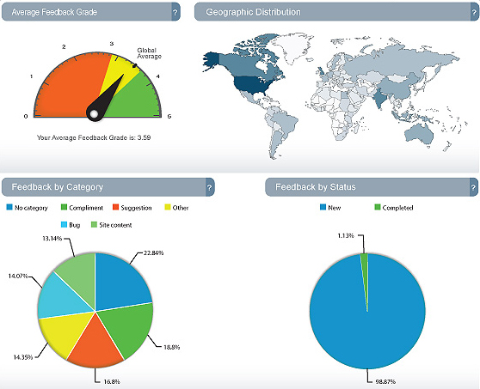
Dashboards
Notes:
Dashboards and scorecards both provide visual displays of important information that is consolidated and arranged on a single screen so that information can be digested at a single glance and easily explored
Despite the plethora of technology available to executives and managers, getting the right kinds of top-line performance information at the right time isn’t always easy.
Business intelligence dashboards designed to reflect actual performance levels against enterprise-wide strategic goals, as well as other key indicators of operational performance.
The dashboard is an interface that presents business information in an instantly understandable format, giving users the meaningful data they need at a glance

Slide 20
How to decide which visual is best?
Visuals: Colour, Branding, Format (data and dashboard) workflow
Consider what data are you showing
Frequency of something
Measure of results
Distribution of data
DEMO of SAMPLE CHARTS *** very useful☺
Notes:
One of the biggest challenges for nontechnical and business users in producing data visualizations is deciding which visual should be used to represent the data accurately
Color—Leverage color to highlight sets of data or
underline what data needs to be grouped together. Bright
and subtle colors can be used in myriad ways, and the hue
of each specific color should be considered individually as
well as within context of other colors. As mentioned above,
avoid using color simply as decoration.
Branding—While branding a dashboard is important to
maintain ownership of the data, especially if the information
is being shared with external audiences, eliminate any
branding that distracts the user from drawing conclusions
from the dashboard.
Dashboard format—Aim to include all necessary data
on one page, or the size of one screen. In addition to color,
use varying shapes to highlight specific sets of data or to
make some information jump out to the user.
Data format—Line charts, bar graphs, pie charts and
gauges help convey important data trends. However, these
visualizations convey only select parts of the story; extra
elements, such as extra grid lines and 3D bars, can be more
distracting than productive.
Workflow organization—Consider how employees
and other users will interact with the dashboard and
embed this expected workflow accordingly. Place data,
objects and shapes so the information can be analyzed
from the top left to the bottom right.

Slide 21
The Question is…
How to design an effective dashboard
that enables organizations to make more informed business decisions, improve solutions and allocate business resources
to enhance the customer’s experience?

Slide 22
Foundations of Data Mining
Data mining is the process of using raw data to infer important business relationships.
Despite a consensus on the value of data mining, a great deal of confusion exists about what it is.
DM is a collection of powerful techniques intended for analyzing large datasets.
There is no single data mining approach, but rather a set of techniques that can be used in combination with each other.

Slide 23
Foundations of Data Mining – cont.
These techniques are often called knowledge data discovery (KDD), and include statistical analysis, neural or fuzzy logic, intelligent agents or data visualization.
The KDD techniques not only discover useful patterns in the data, but also can be used to develop predictive models.

Slide 24
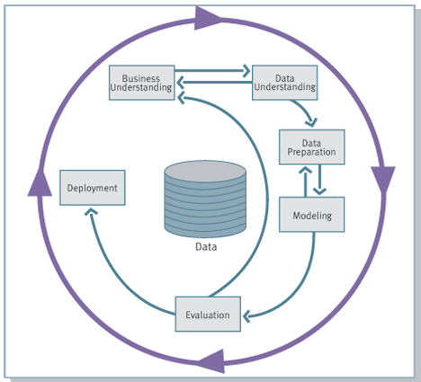
Knowledge Discovery Process flow, according to CRISP-DM
see
www.crisp-dm.org
for more
information
Monitoring

Slide 25
The Roots of Data Mining
The approach has roots in practice dating back over 30 years.
In the early 1960s, data mining was called statistical analysis, and the pioneers were statistical software companies such as SAS and SPSS.
By the 1980s, the traditional techniques had been augmented by new methods such as fuzzy logic, heuristics and neural networks.

Slide 26
Data Mining Technologies
Statistics – the most mature data mining technologies, but are often not applicable because they need clean data. In addition, many statistical procedures assume linear relationships, which limits their use.
Neural networks, genetic algorithms, fuzzy logic – these technologies are able to work with complicated and imprecise data. Their broad applicability has made them popular in the field.
Decision trees – these technologies are conceptually simple and have gained in popularity as better tree growing software was introduced. Because of the way they are used, they are perhaps better called “classification” trees.
Machine learning – artificial intelligence

Slide 27
Techniques Used to Mine the Data
Paralleling the popularity of data mining itself, the development of new techniques is exploding as well.
Many innovations are vendor-specific, which sometimes does little to advance the state of the art.
Regardless, data-mining techniques tend to fall into four major categories:
1. classification 2. association
3. sequencing 4. clustering

Slide 28
Machine Learning / Data Mining Application areas
Science
astronomy, bioinformatics, drug discovery, …
Business
advertising, CRM (Customer Relationship management), investments, manufacturing, sports/entertainment, telecom, e-Commerce, targeted marketing, health care, …
Web:
search engines, bots, …
Government
law enforcement, profiling tax cheaters, anti-terror(?)

Slide 29
What Is Text Analytics?
…turning unstructured customer comments into actionable insights
…finding nuggets of insight in text data that will improve our business
From Wikipedia:
… a set of linguistic, statistical, and machine learning techniques that model and structure the information content of textual sources for business intelligence, exploratory data analysis, research, or investigation

Slide 30


Unstructured Text Processing
Facebook Page
Twitter
Page
Customer Sat Survey Comments
Call
Center
Notes,
Voice
Services
Quality
Cost
Friendliness
Competitors’ Facebook
Pages
Public Web Sites,
Discussion Boards, Product Reviews
Email
Blogs
Alerts,
Real-time Action
Adhoc Feedback

Slide 31
Current Limitations and Challenges to Data Mining
Despite the potential power and value, data mining is still a new field. Some things that that thus far have limited advancement are:
Identification of missing information – not all knowledge gets stored in a database
Data noise and missing values – future systems need better ways to handle this
Large databases and high dimensionality – future applications need ways to partition data into more manageable chunks

Slide 32
Volumes of Data – The Biggest Challenge
The largest challenge a data miner may face is the sheer volume of data in the warehouse.
It is quite important, then, that summary data also be available to get the analysis started.
A major problem is that this sheer volume may mask the important relationships the analyst is interested in.
The ability to overcome the volume and visualize the data becomes quite important.

Slide 33
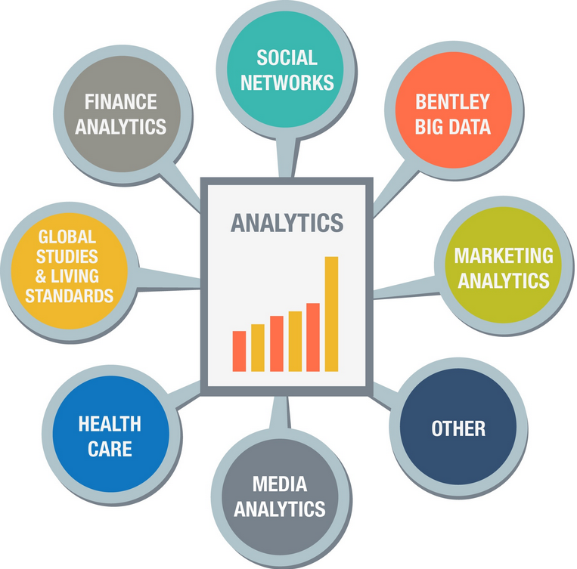

Slide 34
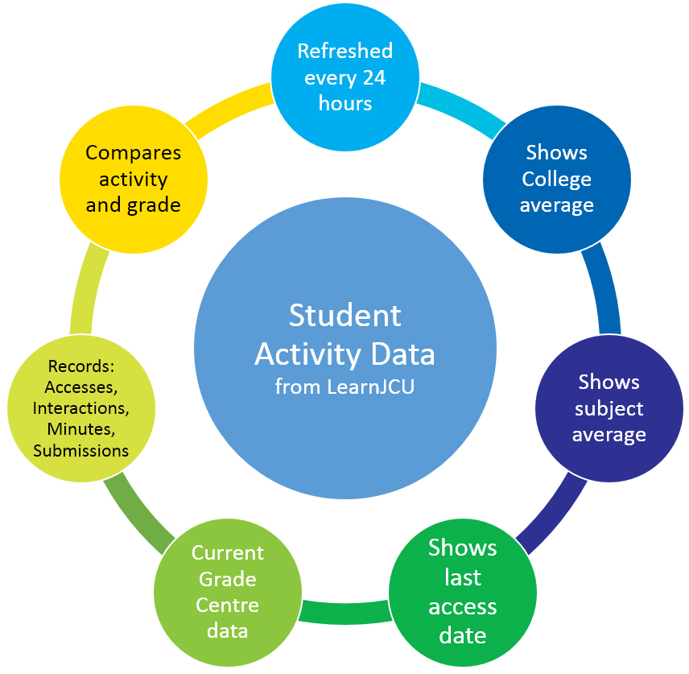
Example: student activity data
Data for Analytics used from:
Library,
Wifi,
MyBeckett,
Attendance,
Banner,
Admission,
Etc…

Slide 35
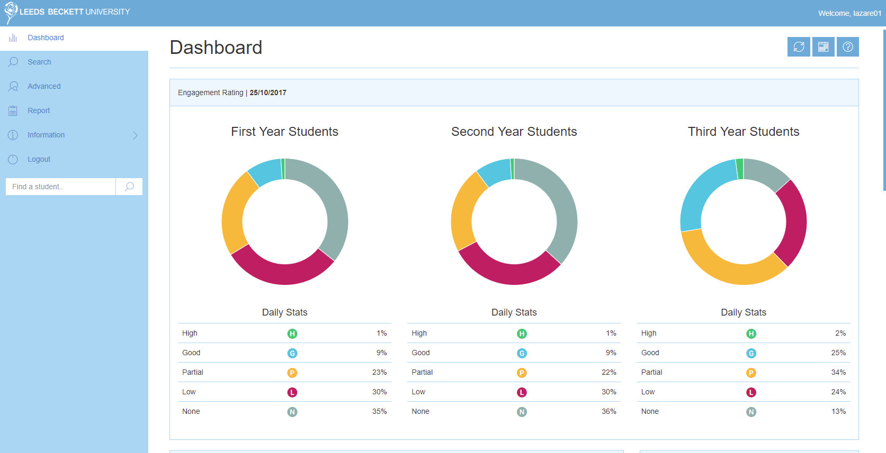
Engagement Data for 25/10/17

Slide 36
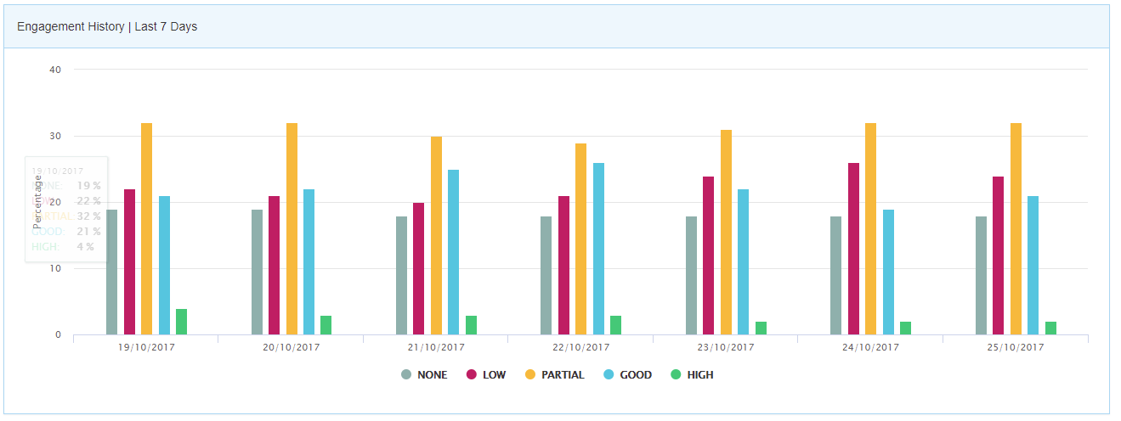
Engagement Data for 25/10/17

Slide 37
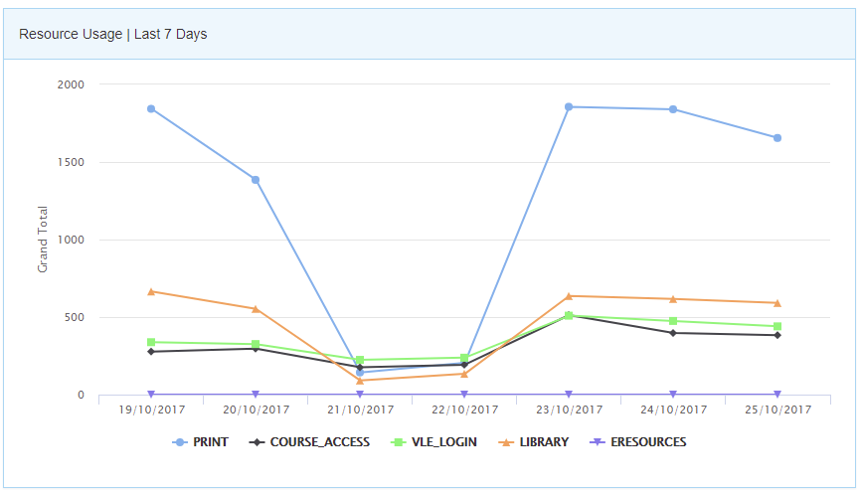
Engagement Data for 25/10/17

Slide 38
Demo sems - 33107621
Can you see any issues with charts just now shown…
https://sems.leedsbeckett.ac.uk/login

Slide 39
Education for Data Science Roles
In-depth knowledge of SAS and/or R.
Python coding along with Java, Perl, C/C++.
Hadoop platform. Experience in Hive or Pig is a huge plus.
SQL database/coding: can write and execute complex queries in SQL.
Working with unstructured data from social media, video feeds, audio, or other sources.
88% of Data Scientists have a Master’s Degree, and 46% have PhDs.
Notes:
https://www.simplilearn.com/data-science-vs-big-data-vs-data-analytics-article

Slide 40
Summary
Data Analytics is important part of Visualisation
Understand your data
Visualisation is here to stay
Big Data will evolve in shape and form

Slide 41

The End
Questions / comments…

Slide 42
Watch
The beauty of data visualization
http://www.ted.com/talks/david_mccandless_the_beauty_of_data_visualization?language=en
The best stats you've ever seen
http://www.ted.com/talks/hans_rosling_shows_the_best_stats_you_ve_ever_seen?language=en

Slide 43
Interesting websites
Many eyes-IBM software
http://www-01.ibm.com/software/analytics/many-eyes/
ODI
http://theodi.org/guides/what-open-data
www.data.gov
http://www.opendataservices.coop/
Data Science
https://www.youtube.com/watch?v=bg7aQ7DEaCo

Slide 44
References
http://www.sas.com/en_us/whitepapers/data-visualization-techniques-106006.html [Accessed 08/04/15]
http://www.teradatauniversitynetwork.com [Accessed 08/04/15]
TURBAN, EFRAIM; SHARDA, RAMESH E; DELEN, DURSUN, DECISION SUPPORT AND BUSINESS INTELLIGENCE SYSTEMS, 9th Ed., ©2011. Reprinted by permission of Pearson Education, Inc. New York, New York.

